Slide 1
“Determination of Time Offset between Audio and Video in Online Repositories (YouTube)” B.Tech. Project End-Term Evaluation
Vikram Voleti 09EE3501

Slide 2
Motivation
To measure time offset between audio signal and video signal in a video
To eliminate redundant videos in a search

Slide 3
Bilabial Consonants
‘p,’ ‘b,’ ‘m’ in the International Phonetic Alphabet
Require the lips to close
Serve as reference points to check for synchronicity

Slide 4
Detection of bilabial consonants in audio: Mel Frequency Cepstral Coefficients (MFCC)
Derived from the audio signal using digital signal processing operations
Well-suited to parameterize human speech
Reduce noise
Mapping is on the Mel scale
Gaussian Mixture Models (GMM)
Parametric probability density function
Weighted sum of Gaussian component densities

Slide 5
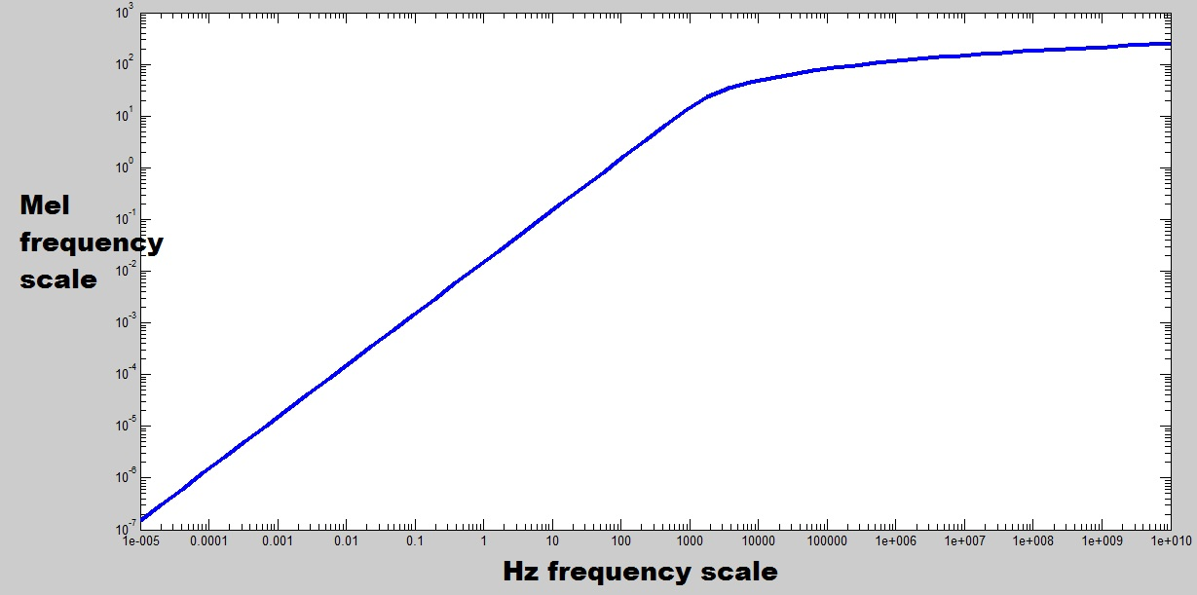
Detection of bilabial consonants in audio: Relation between the Hertz and the Mel scales

Slide 6
Detection of bilabial consonants in audio: Mel Frequency Cepstral Coefficients (MFCC)
Signal
Hamming Window
DFT
Map onto Mel Scale
Log
DCT
MFCC

Slide 7
Detection of bilabial consonants in audio: Training
Calculate MFCC’s for audio signal
Manually identify windows of bilabial sounds in audio signal
Train GMM1 using MFCC’s from bilabial sounds
Train GMM2 using MFCC’s from non-bilabial sounds
Training: Using an Expectation Maximization (EM) algorithm to fit Gaussian curves into the feature vectors

Slide 8
Detection of bilabial consonants in audio: Testing
Calculate MFCC’s for test case
Calculate probability of MFCC features belonging to GMM1 and to GMM2
Subtract the two probabilities and find peaks in the graph of the difference
Maintain a minimum threshold, and note down time instances of peaks

Slide 9
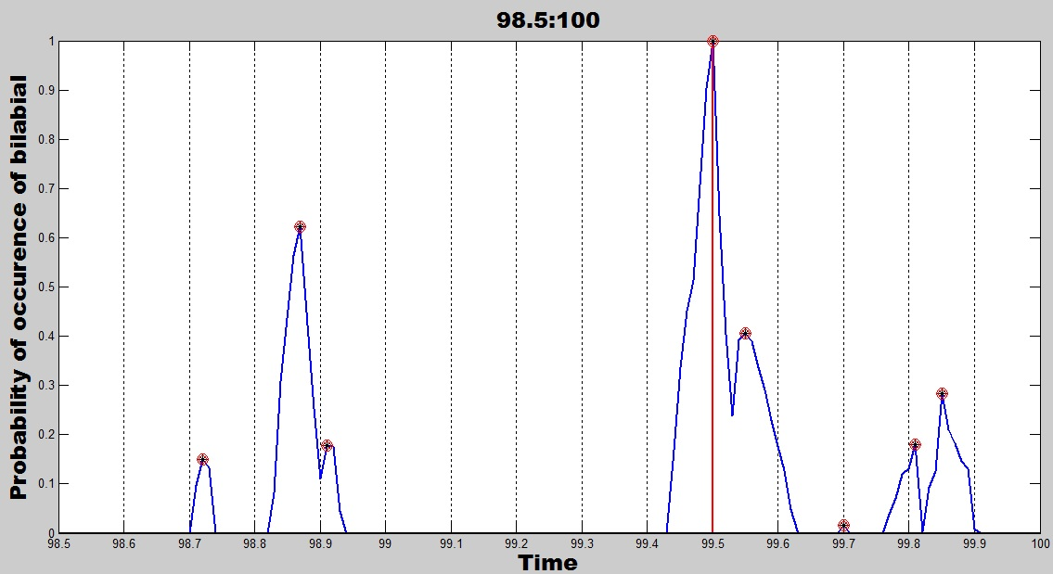
Detection of bilabial consonants in audio: Testing

Slide 10
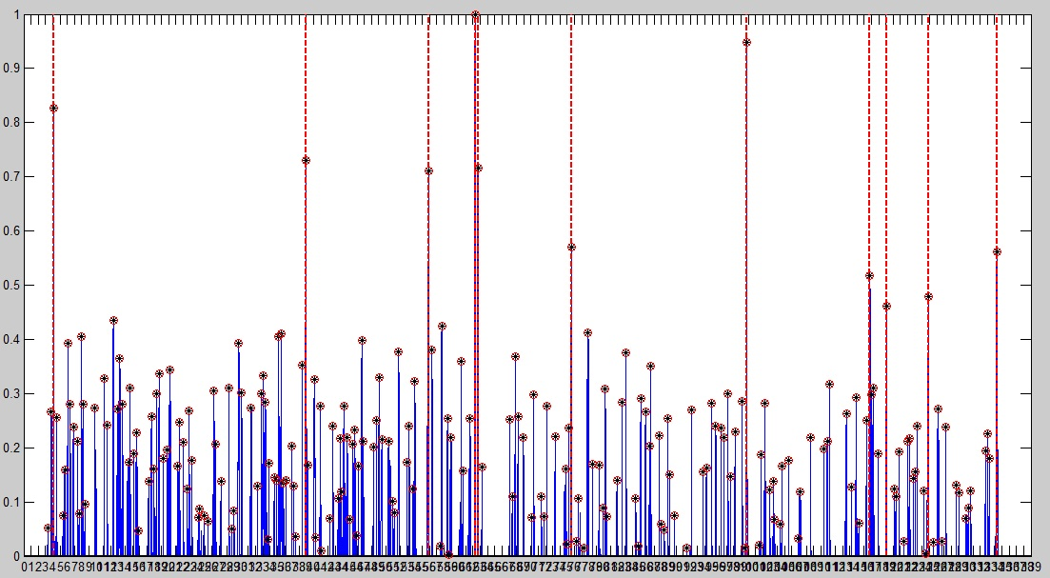
Detection of bilabial consonants in audio: Testing

Slide 11
Detection of bilabials in video
Detect Face using Viola-Jones Algorithm
Detect Mouth in Face using Viola-Jones Algorithm
Filter Mouth with suitable colour range to make binary image of Lip region
Choose a vertical column 3 pixels wide, and record changes in pixel values down the column
Changes in pixel values indicate lip closure or non-closure

Slide 12
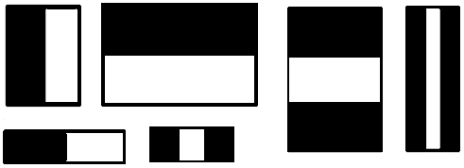
Detection of bilabials in video
Viola-Jones algorithm to detect Face and Mouth
Detect Haar Features
Check if Haar feature is present
Use AdaBoost Algorithm

Slide 13
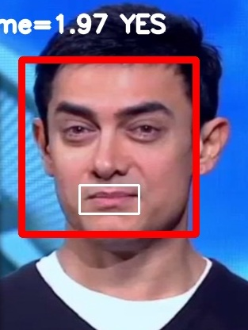
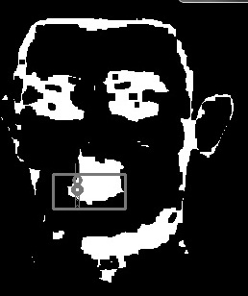

Detection of bilabials in video

Slide 14
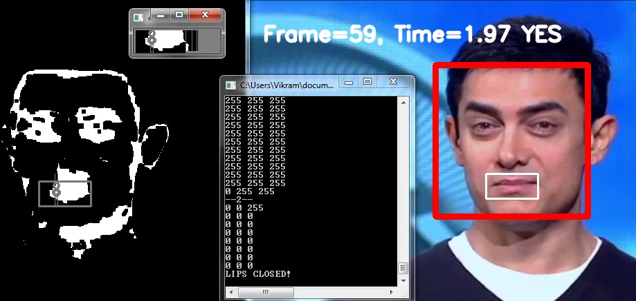
Detection of bilabials in video

Slide 15
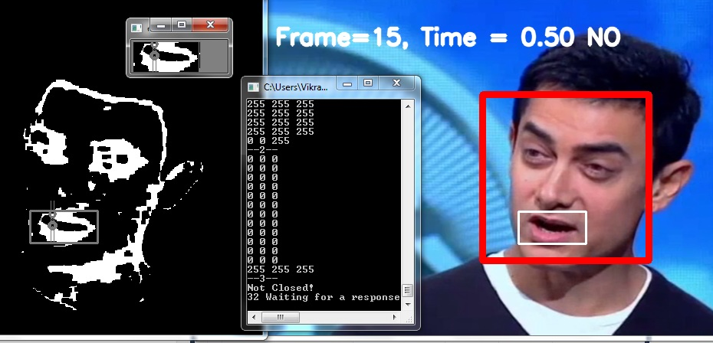
Detection of bilabials in video

Slide 16
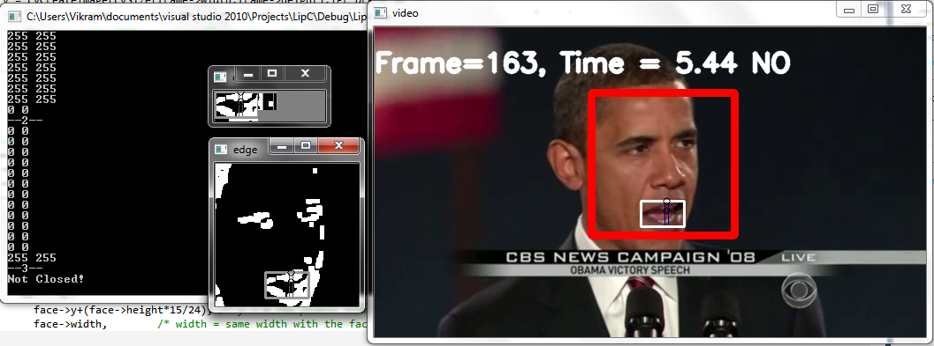
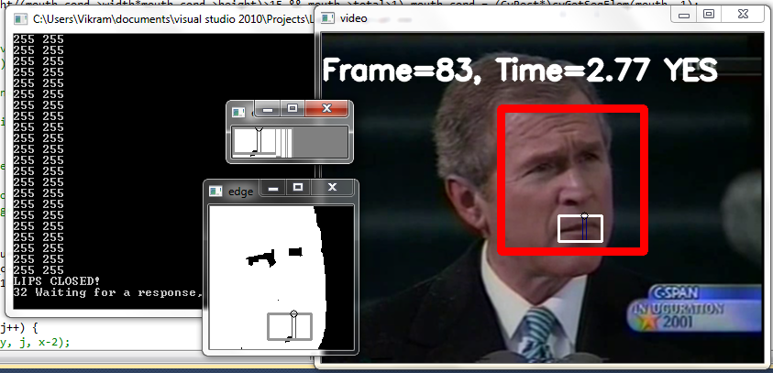
Detection of bilabials in video

Slide 17
Pro’s & Con’s: Detection of bilabials in audio
Successfully uses MFCCs to compute a probability with good success rate.
Is very flexible; parameters of the GMM can be easily changed to better fit the model
This method can only provide a probabilistic determination of bilabials, rather than a classification.
There can be many correct sets of parameters for the GMM to fit the model.
Requires a lot of training data.

Slide 18
Pro’s & Con’s: Detection of bilabials in video
Checking for lip-closure in video is more error-free than checking for bilabials in audio.
This method can work for videos with low quality, as are very often found in online repositories such as YouTube.
No training required.
Can be easily implemented in OpenCV rather than MATLAB for faster results.
Cannot detect face and lip regions if head is tilted beyond a certain angle (only in rare cases).
Colour range chosen to detect lips may need to be dynamically varied depending on the gender and ethnicity of the speaker
Frame rate of the video affects the accuracy of the time at which lip closure is detected.

Slide 19
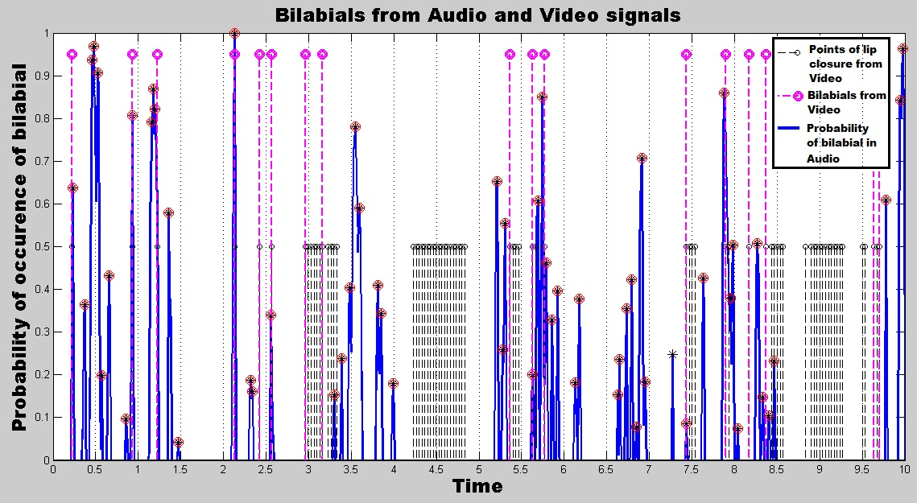
Detection of bilabials in video & audio

Slide 20
Vowel Detection
The speech sample is zero-centred and normalized.
The Power Spectrum of the normalized zero-centred speech sample is determined using the Yule-Walker method.
The frequencies where the first three peaks occur in the Power Spectrum are noted as the Formants of the speech signal.
The three frequencies, combined with their respective weights, are compared to pre-determined formant frequency values for the different vowel sounds.
If the error between the formant frequencies of the speech sample and any one of the vowels is less than a threshold value, then it is claimed that the speech sample in consideration contains a vowel.
This method was judged redundant after experimentation.

Slide 21
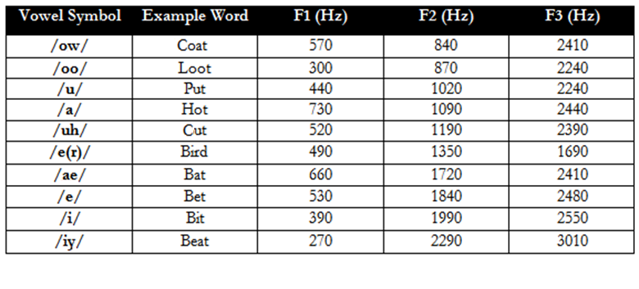
Vowel Detection

Slide 22
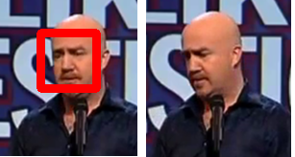
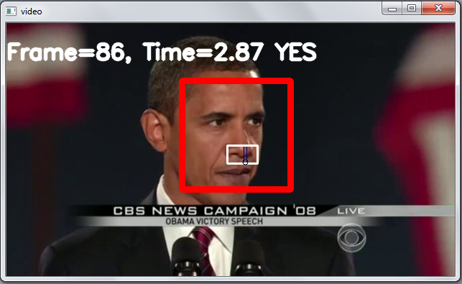
Errors in Lip Closure Detection in Video
1. Error due to Viola – Jones Algorithm used to detect face and mouth
Limitation to head tilt
Experimental threshold values of Haar Classifiers

Slide 23
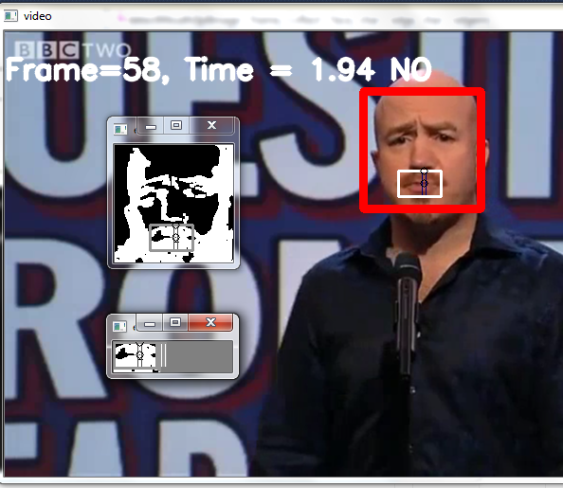
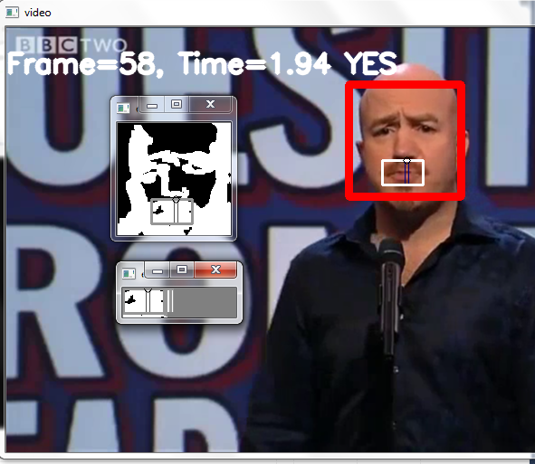
Errors in Lip Closure Detection in Video
2. Error due to Colour Filtering

Slide 24
Errors in Lip Closure Detection in Video
3. Error due to Frame Rate
Frame rate of a typical video is limited to 29fps.
This implies a gap of around 35msecs between two frames.
Thus, lip closure is detected with an error margin of +35msecs to -35msecs.

Slide 25
Errors in Bilabial Detection in Audio
1. Error due to MFCC
Only an approximate model of human auditory response
2. Error in Training Data
1) inclusion of non-bilabial points into the GMM,
2) exclusion of bilabial points from the GMM.

Slide 26
Errors in Bilabial Detection in Audio
3. Error in the Gaussian Mixture Model
1) Number of Iterations if the Expectation Maximisation algorithm
Increase in number of iterations can lead to a more accurate model, but would take more time to train
2) Over-fitting
‘ma’ occurs more frequently than ‘pa’ or ‘ba’
More number of training points within a small area could over-work the training algorithm
3) Number of Gaussians in the Mixture
More the number of Gaussians, more accurate is the fit, but the training is slower

Slide 27
Conclusion & Future Work
Time offset can be detected for audio samples of highest probability of bilabial consonant, and a lip closure upto an error margin of 35msecs
Better training data for GMM
Inclusion of other algorithmic checks to reduce errors in lip detection, such as Scale-invariant feature transform (or SIFT), and Principal Component Analysis
Making of a synthetic video as a test case for the program

Slide 28
Thank you.

